Slide 1
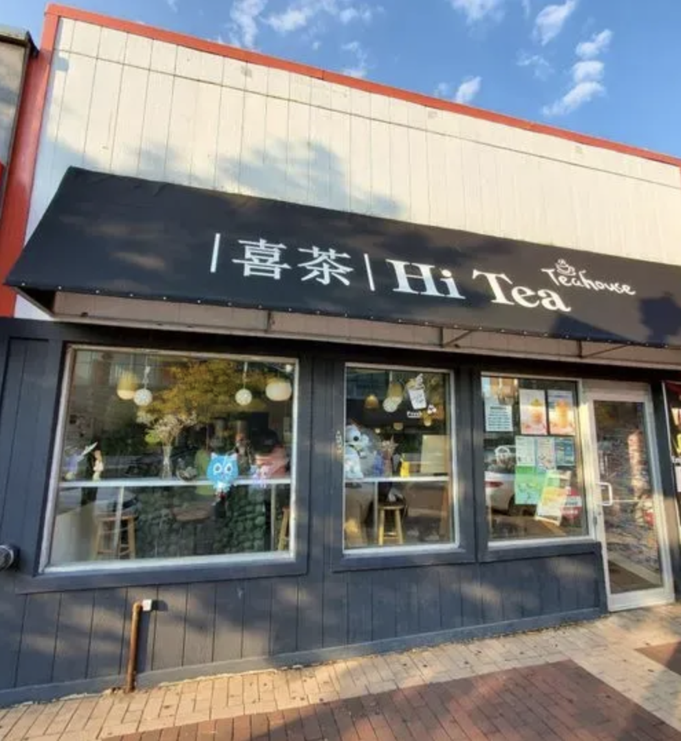
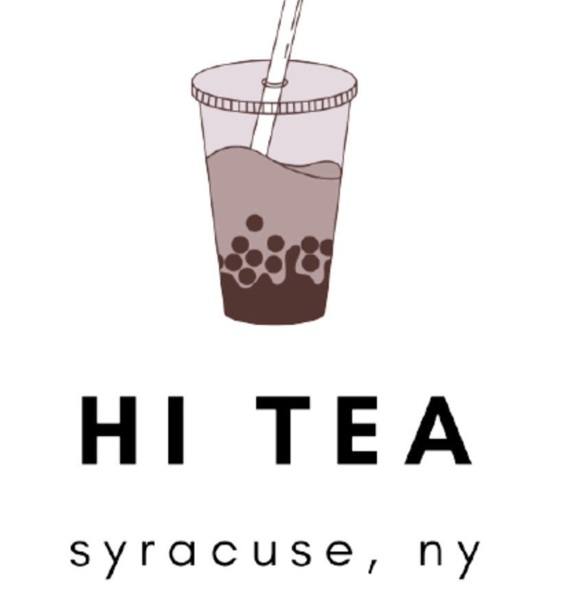

Slide 2
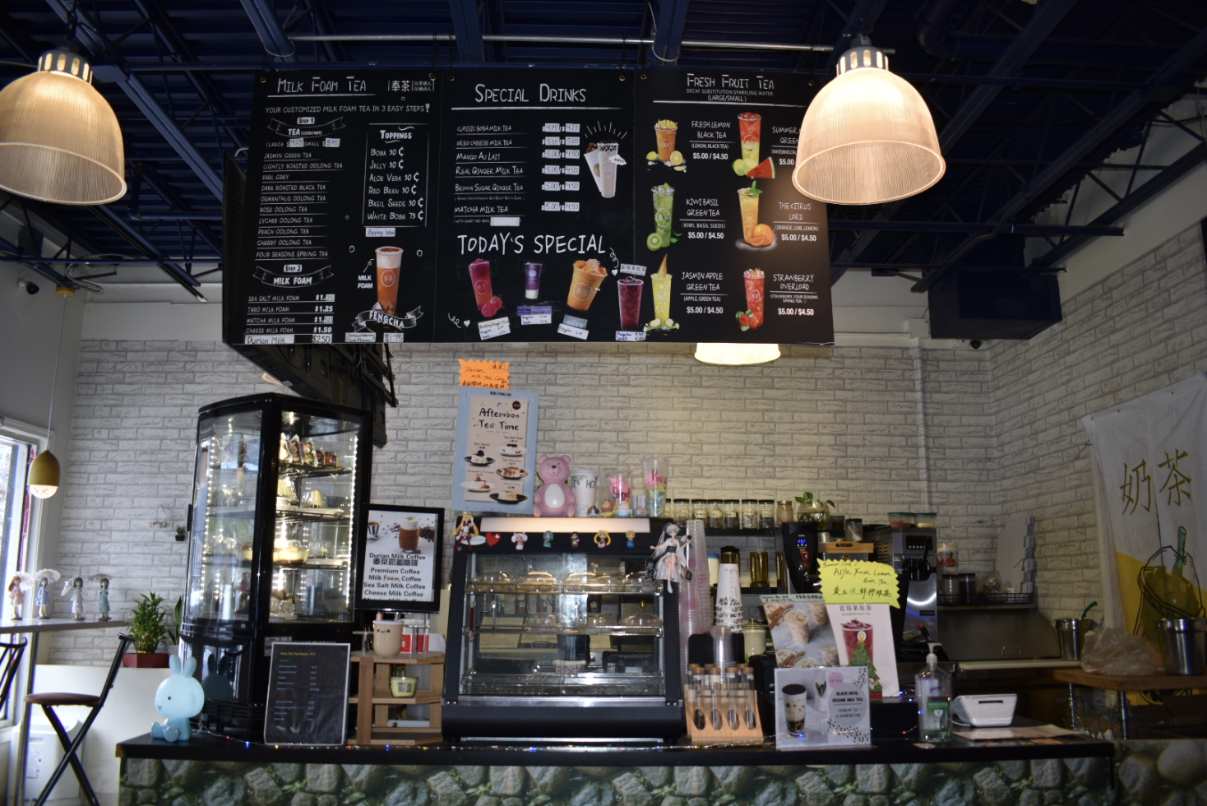
Client Profile : Overview
At Hi Tea, enjoy personalized bubble teas with authentic ingredients. Choose from plant-based milk, sugar levels, ice, toppings, and milk foam for a tailored experience worth returning for.
Location : 113 Marshall St Syracuse, NY 13210
Industry : Food and Beverages
Founded : 2016
Rebranded : 2022
Company Size : 2-10 employees
Social Media Presence across Instagram, Commercial Website and LinkedIn, Facebook
Contact info : 315-901-2990, hiteasyracuse@gmail.com

Slide 3
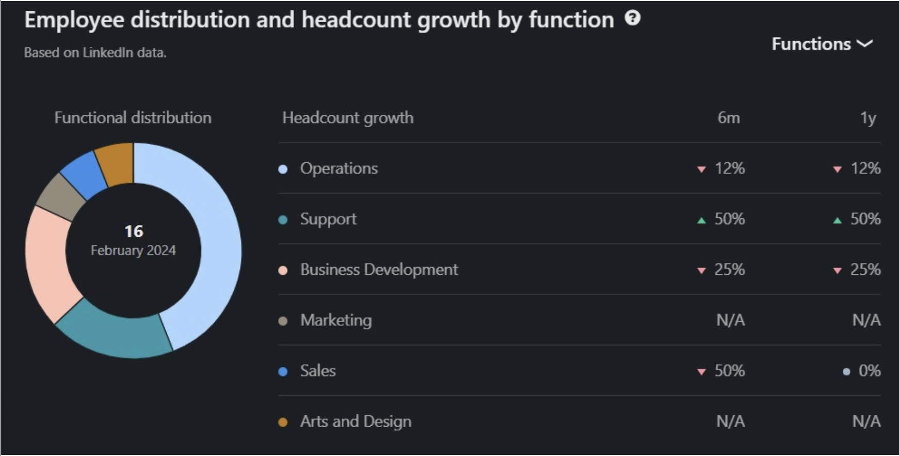
Client Profile Overview
On the right side, there is a table with two columns indicating headcount growth over two time periods: 6 months (6m) and 1 year (1y). This table includes several functions:
Operations: There has been a 12% decrease in headcount in both the last 6 months and the last year.
Support: There has been a 50% increase in headcount in both the last 6 months and the last year.
Business Development: There has been a 25% decrease in headcount in both the last 6 months and the last year.
Marketing: No data/person is available.
Sales: There has been a 50% decrease in headcount over the last 6 months, and no change (0%) over the last year.
Arts and Design: No data is available (N/A) for headcount growth.
The arrows next to the percentages indicate the direction of the change: green upward arrows for growth, pink downward arrows for reduction.

Slide 4
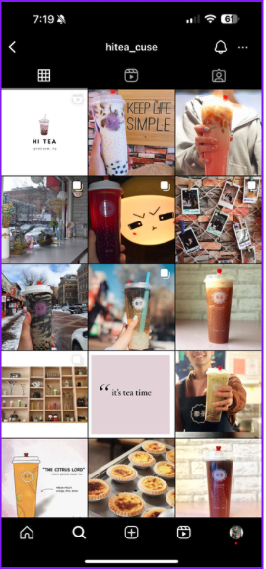
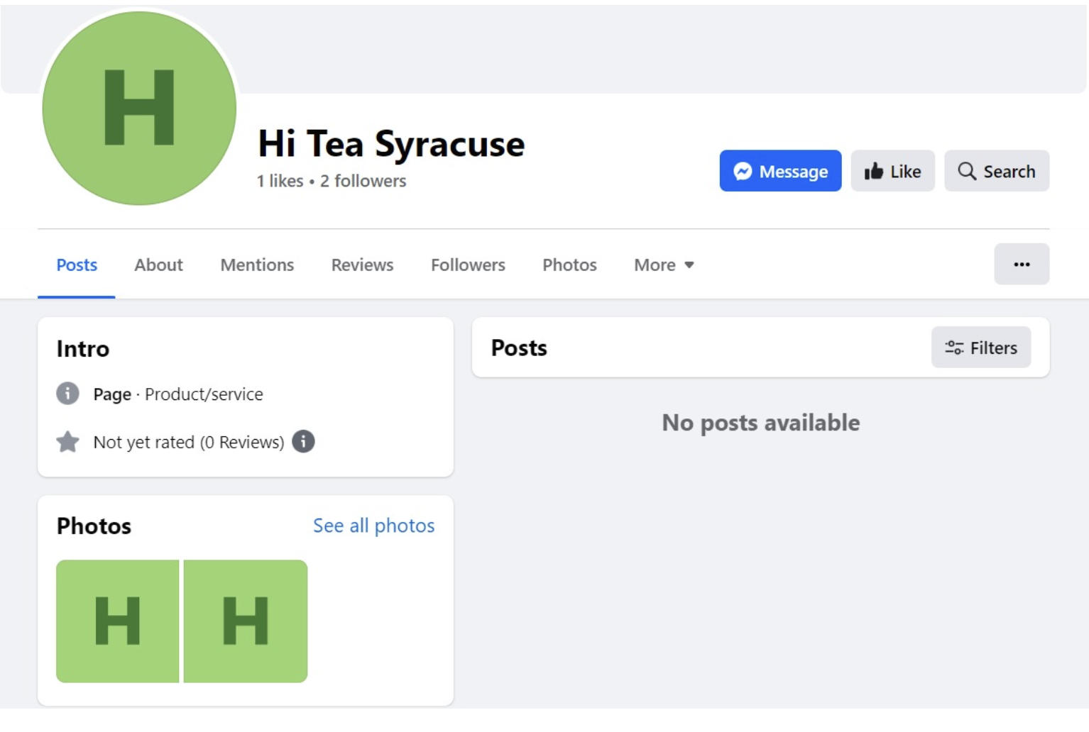
Digital Marketing Presence
Current Efforts:
Very few posts on Instagram
Wrong platform promotion
No online advertising
Followers:
Instagram – 280 followers
Facebook – 2 followers
Twitter – N/A

Slide 5
SWOT Analysis
Strengths :
- Closer to SU campus
- Customization (offers extensive customization options, catering to individual taste preferences)
- Quality ingredients (use of authentic flavors enhances the quality and flavor of beverages)
Weaknesses:
- Not widely spread within the city (limited recognition)
- Dependency on trends (it is highly dependent on the product bubble tea, the market is subject to changing trends
- Not a strong social media presence (can improve to attract more customers, have very few followers)
Opportunities:
- Social media marketing (using engaging visual, short format content, collaboration with SU students especially content creators to get promotion and recognition)
- Offer more promotions
Threats:
- Competition (there are other cafes and fast- food outlets close by)
- Examples: Tai chi Bubble Tea, Mist Tea Cafe

Slide 6
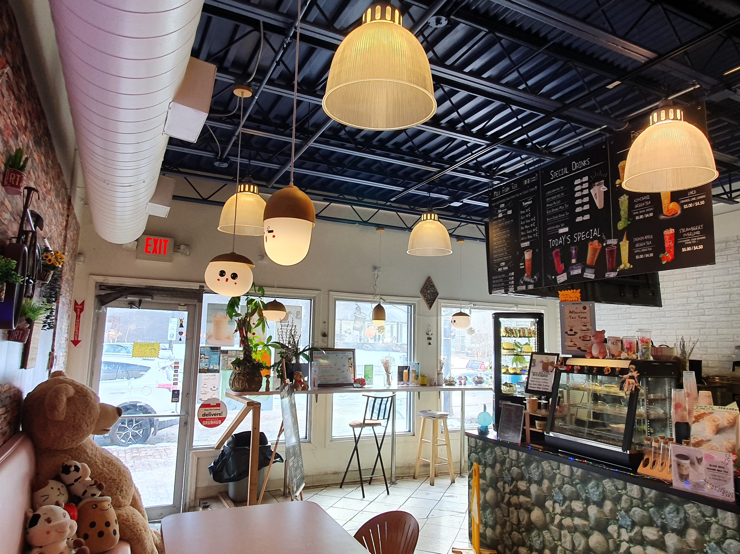
Digital Marketing Objectives
Attract more students
Take advantage of ideal location
Improve overall brand name

Slide 7
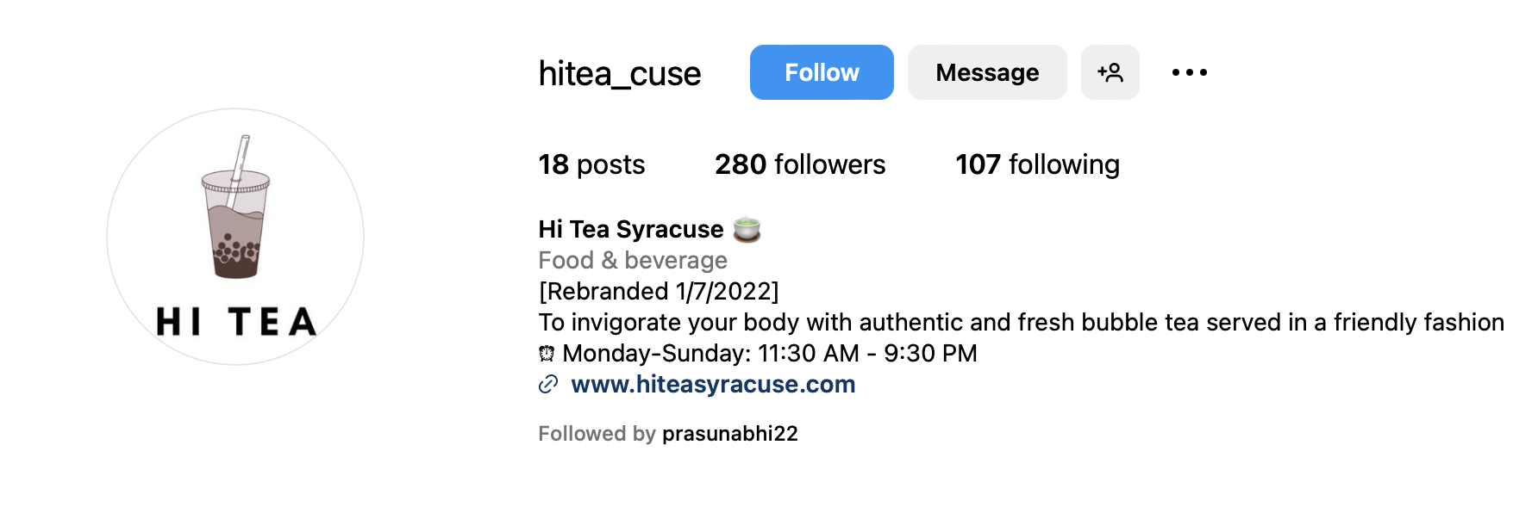
Areas for improvement and Pain Points
Website is not conversion centered.
There not many followers on Instagram and Facebook.
Social Media posts are not engaging and are not frequently made.
Client is not utilizing short format content for user engagement.
Very less frequent user engagement strategies like polls, votes, giveaways or discounts.
Not leveraging chances to spread across other locations within the city due to point focus on students only as customers.

Slide 8
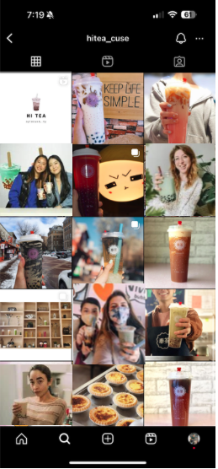
A/B Test Design
Version A
Product oriented
Version B
People oriented
Opportunities to improve:
Increase user engagement on Instagram profile
Outcome variables:
Conversion rate
Number of followers, likes & reach

Slide 9
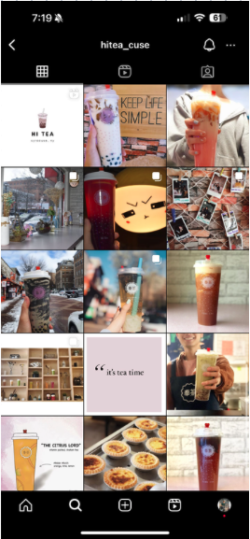
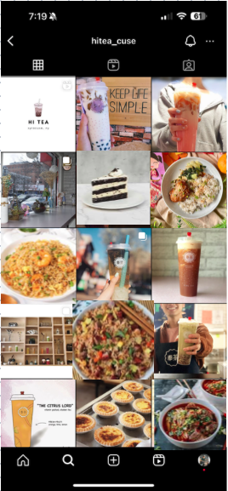
A/B Test Design
Version A
Product oriented (Beverage)
Version B
Product oriented (Beverage and Food)
Opportunities to improve:
Enhance user engagement by improving Instagram posts
Outcome variables:
Conversion rate
Number of followers, likes & reach

Slide 10
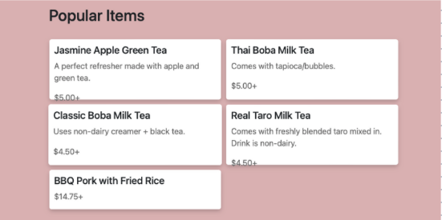
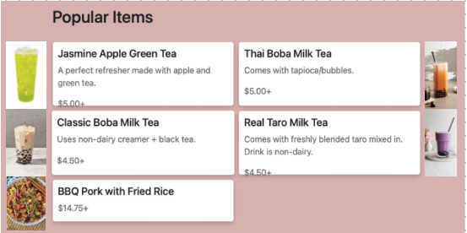
A/B Test Design
Version A
Product oriented (Description)
Version B
Product oriented (Pictorial Description)
Opportunities to improve:
Enhance user engagement by improving Instagram posts
Outcome variables:
Conversion rate
Number of followers, likes & reach

Slide 11
